Slide 1
COLLEGE DATA SYSTEM
-Ananya
-Rishitha
-Sravani

Slide 2
ABSTRACT
The College data system using Cis a location where a student can have all the information they need.
Each section has different information according to need of student like search class routine, bus schedule, teacher information, subjects list, assignments, quizzes and college events..
This system is very useful for fresher student because they have no idea about college teachers and many more things. Admin section have their separate login system.
With the password given to Admin, they can access the page from where they can change, update, delete the information.
Whenever student accesses quizzes and assignments, if there are any pending assignments the student gets remainder.

Slide 3
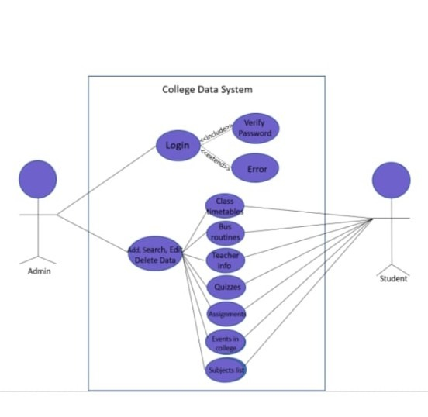
USECASE DIAGRAM
USECASE DIAGRAM:

Slide 4
TECHNOLOGY USED:
All compute software needs certain hardware components or other software components resources to be present. In order for computers to used efficiently these are the primary requisites. There are two different categories of this section.
a. Software Requirements:
Software requirements mainly share out with defining the software resource requirements that need to be installed on a computer to provide optimal functioning of a particular application. These conditions are not included in the software installation package and need to be installed separately.
In order to use “College Data System” the following are the prerequisites,
a. Operating System – Windows 7 and above
b. C Compiler – GNU Compiler(GCC)
c. Editor – Any basic editor is preferable
b. Hardware Requirements:
Hardware requirements refer to the common set requirements defined by any operating system or software application and are usually the physical computer resources. In this section we basically deal with primary memory, secondary memory, processing power.
In order to use “College Data System” one should have the following,
a. Processor - Intel Core i5 and above
b. Memory – 4GB Ram

Slide 5
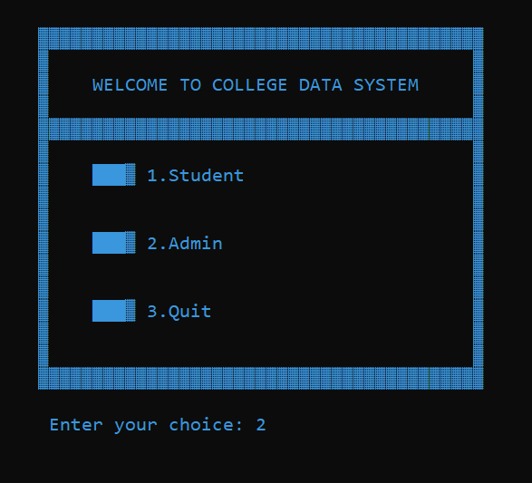
RESULTS:

Slide 6
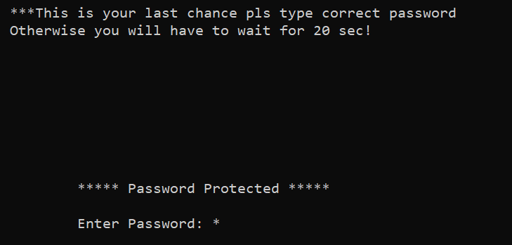
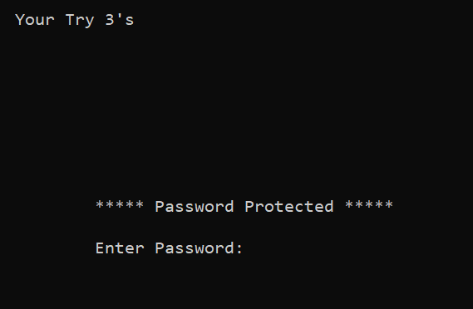
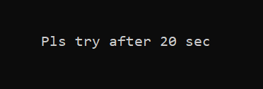
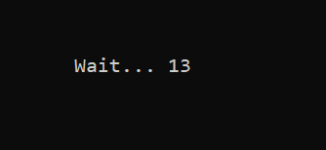

Slide 7
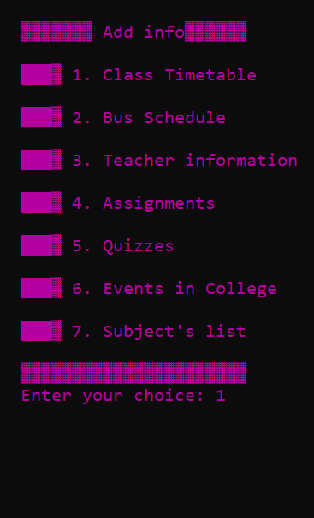
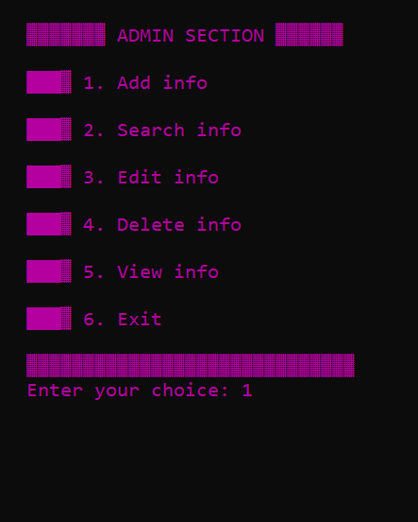
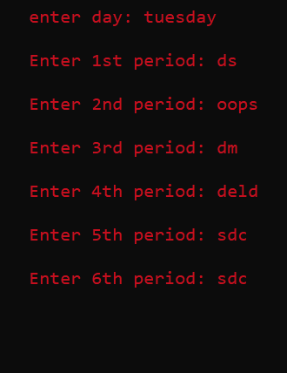

Slide 8
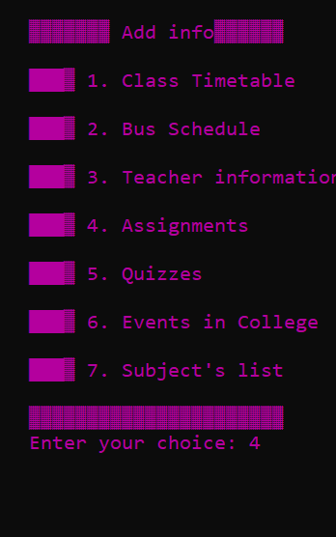
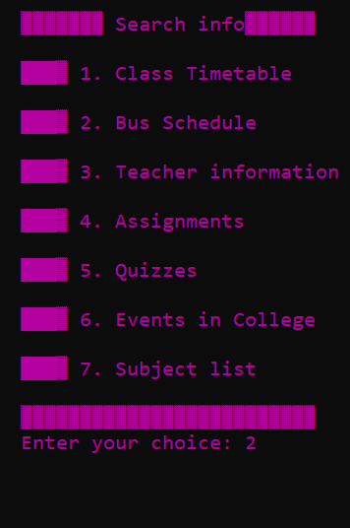
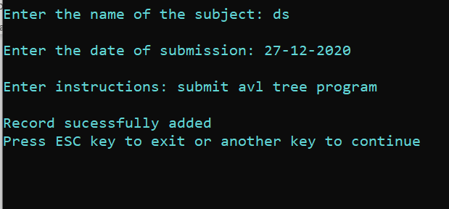

Slide 9
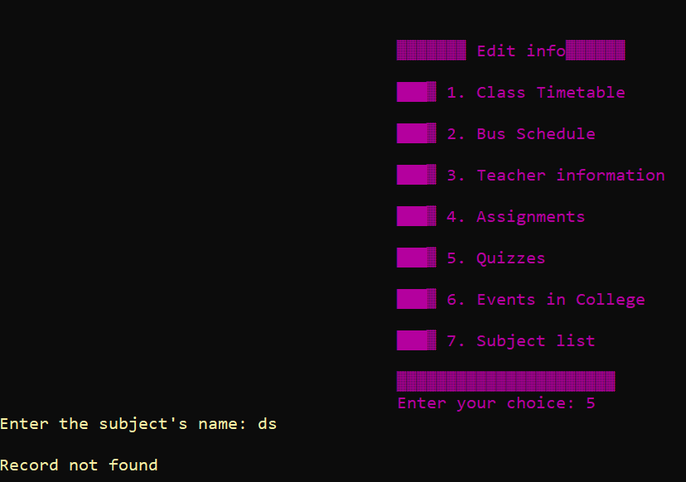
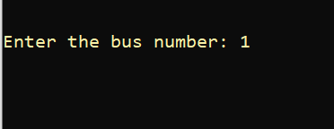

Slide 10
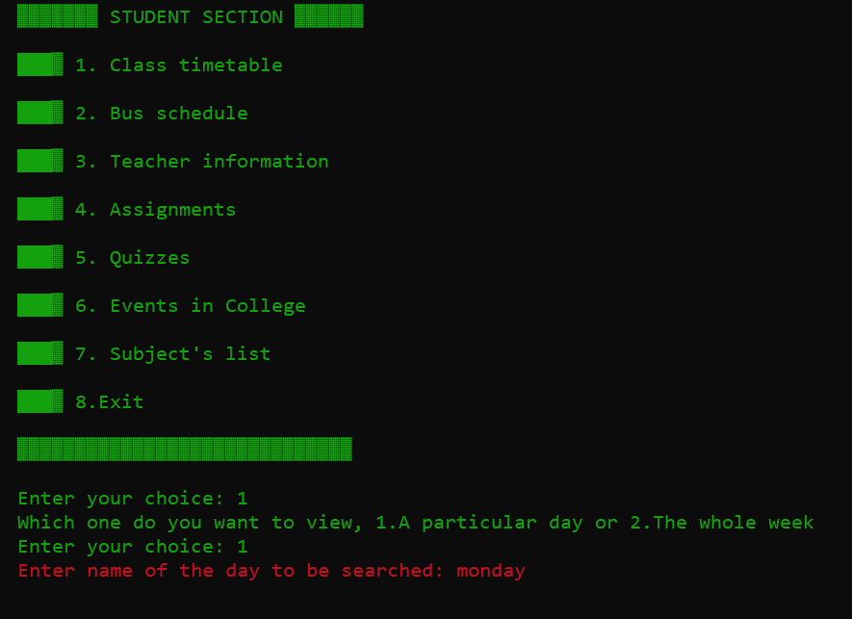
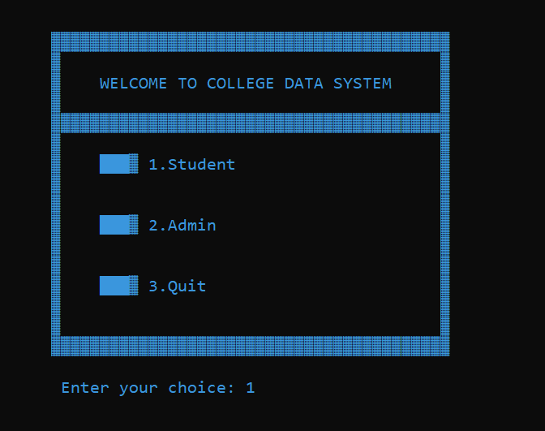
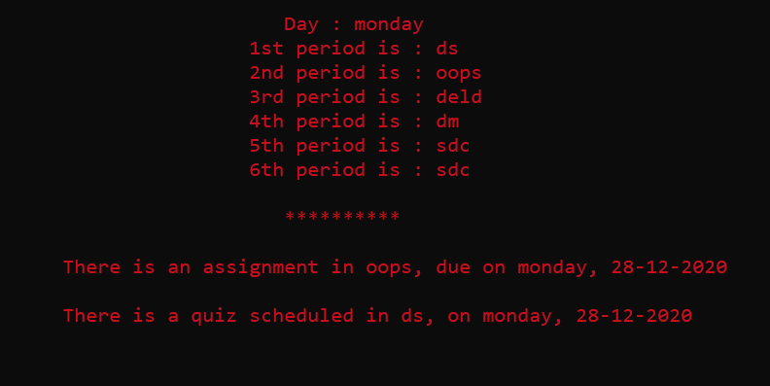

Slide 11
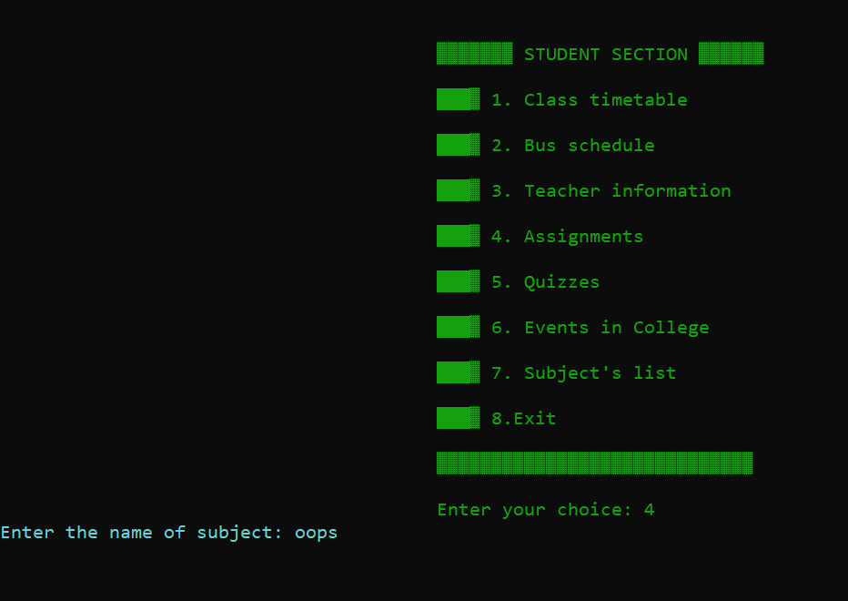
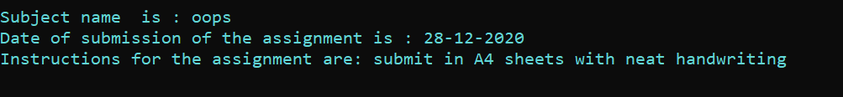

Slide 12
CONCLUSION AND FUTURE WORK
We conclude that the project will be useful to the students to get information related to their academics.
It can be operated easily and everyone can handle it comfortably.
Our future work includes incorporating more concepts such as Data Structures in our code.​
Also, we would like to include a feature which allow the student to send requests to the Admin for any changes they require.

